Slide 1
OpenTelemetry with New Relic
Harry Kimpel
@harrykimpel

Slide 2
Agenda
01
02
03
Business objectives
New Relic
OpenTelemetry
04
05
Demo
Resources

Slide 3
New Relic

Slide 4
Modern observability business objectives
Maximize Uptime
Optimize Business
Improve system resilience
Ensure peak performance
Increase application security
Improve real-user experience
Decrease cloud hosting costs
Consolidate tools
Innovate Faster
Operation Efficiency
Drive developer productivity
Increase release velocity
Accelerate app modernization
Reduce administrational overhead
Drive developer productivity
Reduced maintenance efforts

Slide 5
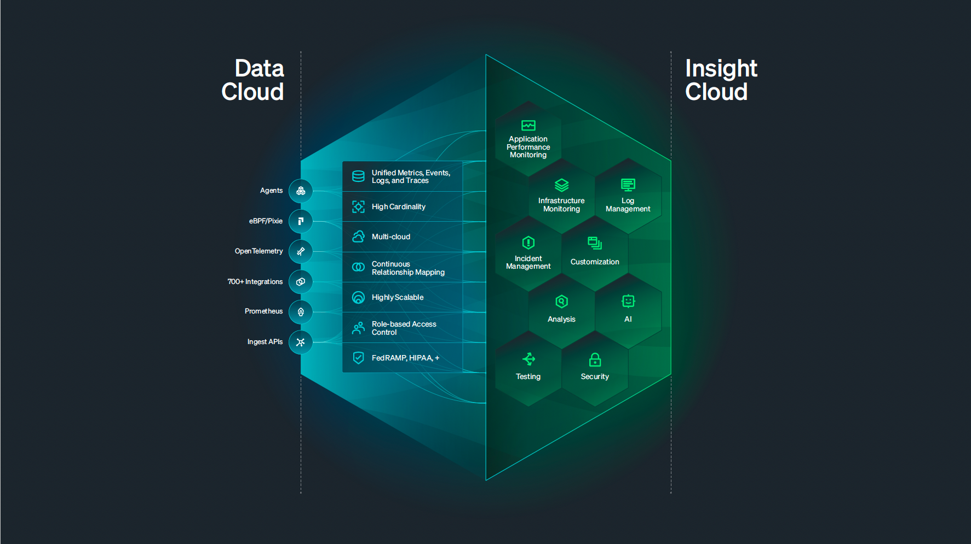


New Relic all-in-one observability platform
All Telemetry
All Teams
Metrics
Dev
Ops
Events
Network
Infrastructure
Logs
SRE
Security
Traces
Web
Mobile
{ API }
3rd party telemetry
Back-End
Cloud

Slide 6
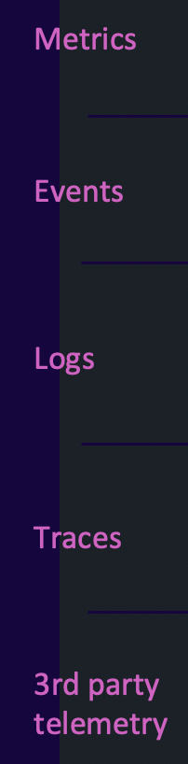
New Relic all-in-one observability platform
All Telemetry
All Teams
Metrics
Dev
Ops
Events
Network
Infrastructure
Logs
SRE
Security
Traces
Web
Mobile
{ API }
3rd party telemetry
Back-End
Cloud

Slide 7

New Relic all-in-one observability platform
All Telemetry
All Teams
Metrics
Dev
Ops
Events
Network
Infrastructure
Logs
SRE
Security
Traces
Web
Mobile
{ API }
3rd party telemetry
Back-End
Cloud

Slide 8

New Relic all-in-one observability platform
All Telemetry
All Teams
Metrics
Dev
Ops
Events
Network
Infrastructure
Logs
SRE
Security
Traces
Web
Mobile
{ API }
3rd party telemetry
Back-End
Cloud

Slide 9
Data Cloud All telemetry correlated in one place
Largest open-source ecosystem
Full OpenTelemetry support
3.1 Exabytes of data ingested/year
12 Billion events processed/minute
Support 10’s thousands concurrent customers
Highly secure and resilient environment

Slide 10

Insight Cloud All monitoring tools in one experience
Automated AI-powered insights
Generative AI assistance
Instant anomaly detection
Automated incident management & Alerts
End-to-end visibility across environments
Full-stack monitoring capabilities

Slide 11


The Rise of OpenTelemetry
OpenTelemetry is a CNCF project
Formed through a merger of the OpenTracing and OpenCensus projects in 2019
Vendor-agnostic - set of APIs, libraries, integrations, and a collector service for telemetry
Standardizes how you collect telemetry data from your applications and services
Send it to an observability platform of your choice

Slide 12


Design Considerations & Guidelines
Customize Everything
(manual instrumentation)
End Product
(auto instrumentation)
Ingredients
Custom Made
Flavours
Ready to Eat
Packaged
Scalable
.NET, Java, and others mature
Most Languages

Slide 13

Demo: eShop application with OpenTelemetry
Collect all your telemetry

Slide 14
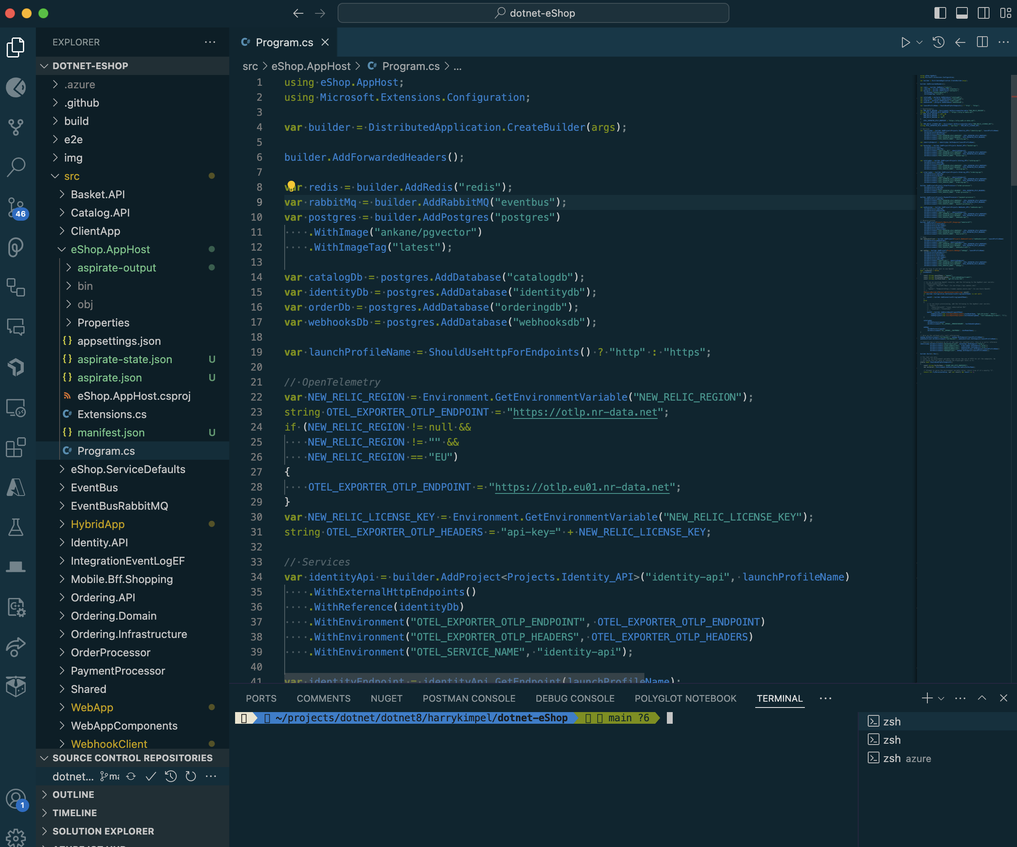
.NET Aspire AppHost configuration
Configure OpenTelemetry
Leverage an OTLP endpoint
OTLP = OpenTelemetry Line Protocol
Configure API key

Slide 15
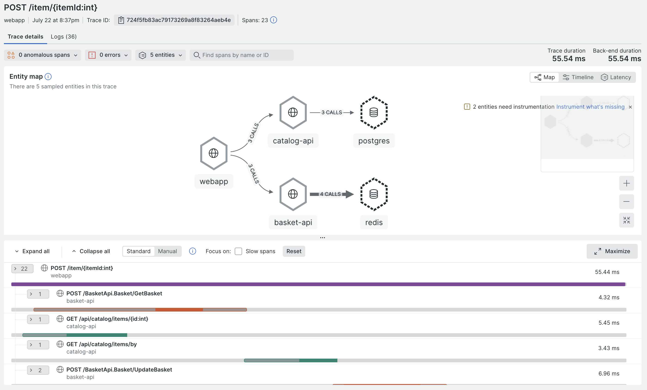
Connected experiences
All telemetry available in context and correlated with each other

Slide 16
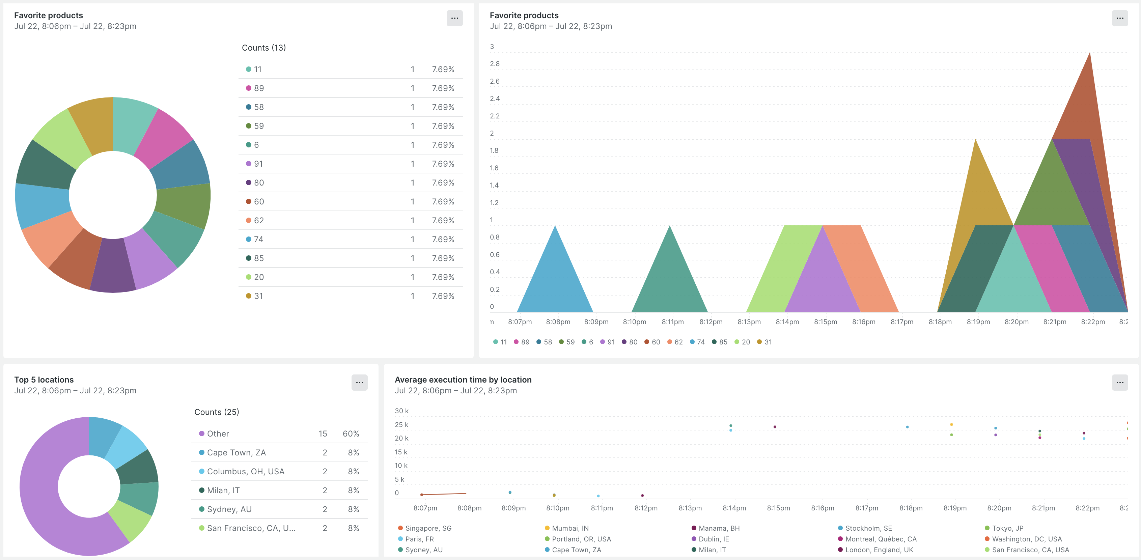
Custom dashboards
Visualize any combination of data
All telemetry including traces, metrics and logs
Custom events and attributes
High cardinality

Slide 17
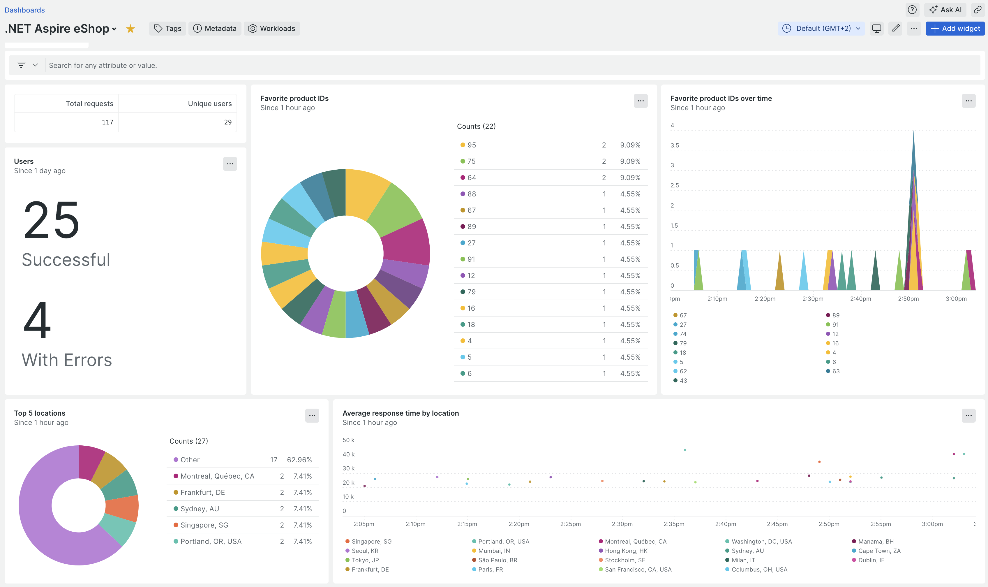

Slide 18

Resources
https://learn.microsoft.com/en-us/dotnet/aspire/
https://learn.microsoft.com/en-us/training/modules/use-telemetry-dotnet-aspire/
.NET Aspire documentation
Use telemetry in a .NET Aspire project
https://docs.newrelic.com/docs/new-relic-solutions/get-started/intro-new-relic/
https://docs.newrelic.com/docs/opentelemetry/opentelemetry-introduction/
Introduction to New Relic
OpenTelemetry with New Relic
https://opentelemetry.io/docs/languages/net/getting-started/
https://github.com/dotnet/eShop
OpenTelemetry Getting Started with .NET
eShop Reference Application - "AdventureWorks"

Slide 19
.NET Aspire Developers Day
Start your learning journey:
aka.ms/dotnetAspireDevDay/Collection

